Slide 1

Customer Shopping Behavior Analysis
This project analyzes customer shopping behavior using transactional data from 3,900 purchases across various product categories. The goal is to uncover insights into spending patterns, customer segments, product preferences, and subscription behavior to guide strategic business decisions.

Slide 2
Dataset Summary
Rows: 3,900
Columns: 18
Key Features:
Customer demographics (Age, Gender, Location, Subscription Status)
Purchase details (Item Purchased, Category, Purchase Amount, Season, Size, Color)
Shopping behavior (Discount Applied, Promo Code Used, Previous Purchases, Frequency of Purchases, Review Rating, Shipping Type)
Missing Data: 37 values in Review Rating column

Slide 3
Exploratory Data Analysis using Python
We began with data preparation and cleaning in Python:
Data Loading:
Imported the dataset using pandas.
Initial Exploration:
Used df.info() to check structure and .describe() for summary statistics.
Missing Data Handling:
Checked for null values and imputed missing values in the Review Rating column using the median rating of each product category.
Column Standardization:
Renamed columns to snake case for better readability and documentation.
Feature Engineering:
Created age_group column by binning customer ages.
Created purchase_frequency_days column from purchase data.
Data Consistency Check:
Verified if discount_applied and promo_code_used were redundant; dropped promo_code_used.
Database Integration:
Connected Python script to PostgreSQL and loaded the cleaned DataFrame into the database for SQL analysis.

Slide 4
Data Analysis using SQL (Business Transactions)
We performed structured analysis in PostgreSQL to answer key business questions:
1. Revenue by Gender
Compared total revenue generated by male vs. female customers.
gender
revenue
Female
75191
Male
157890
2. High-Spending Discount Users
Identified customers who used discounts but still spent above the average purchase amount.
customer_id
purchase_amount
2
64
3
73
4
90
7
85
9
97
12
68
13
72
16
81
20
90
22
62
24
89
Total rows: 839 Query complete 00:00:00

Slide 5
Data Analysis using SQL (Business Transactions) - Continued
3. Top 5 Products by Rating
Found products with the highest average review ratings.
item_purchased
Average Product Rating
Gloves
3.86
Sandals
3.84
Boots
3.82
Hat
3.80
Skirt
3.78
4. Shipping Type Comparison
Compared average purchase amounts between Standard and Express shipping.
shipping_type
round
Standard
58.46
Express
60.48

Slide 6
Data Analysis using SQL (Business Transactions) - Further Insights
5. Subscribers vs. Non-Subscribers
Compared average spend and total revenue across subscription status.
subscription_status
total_customers
avg_spend
total_revenue
Yes
1053
59.49
62645.00
No
2847
59.87
170436.00
6. Discount-Dependent Products
Identified 5 products with the highest percentage of discounted purchases.
item_purchased
discount_rate
Hat
50.00
Sneakers
49.66
Coat
49.07
Sweater
48.17
Pants
47.37

Slide 7
Customer Segmentation and Product Ranking
7. Customer Segmentation
Classified customers into New, Returning, and Loyal segments based on purchase history.
customer_segment
Number of Customers
Loyal
3116
New
83
Returning
701
8. Top 3 Products per Category
Listed the most purchased products within each category.
item_rank
category
item_purchased
total_orders
1
Accessories
Jewelry
171
2
Accessories
Sunglasses
161
3
Accessories
Belt
161
1
Clothing
Blouse
171
2
Clothing
Pants
171
3
Clothing
Shirt
169
1
Footwear
Sandals
160
2
Footwear
Shoes
150
3
Footwear
Sneakers
145
1
Outerwear
Jacket
163
2
Outerwear
Coat
161

Slide 8
Subscription Behavior and Revenue by Age Group
9. Repeat Buyers & Subscriptions
Checked whether customers with >5 purchases are more likely to subscribe.
subscription_status
repeat_buyers
No
2518
Yes
958
10. Revenue by Age Group
Calculated total revenue contribution of each age group.
age_group
total_revenue
Young Adult
62143
Middle-aged
59197
Adult
55978
Senior
55763

Slide 9
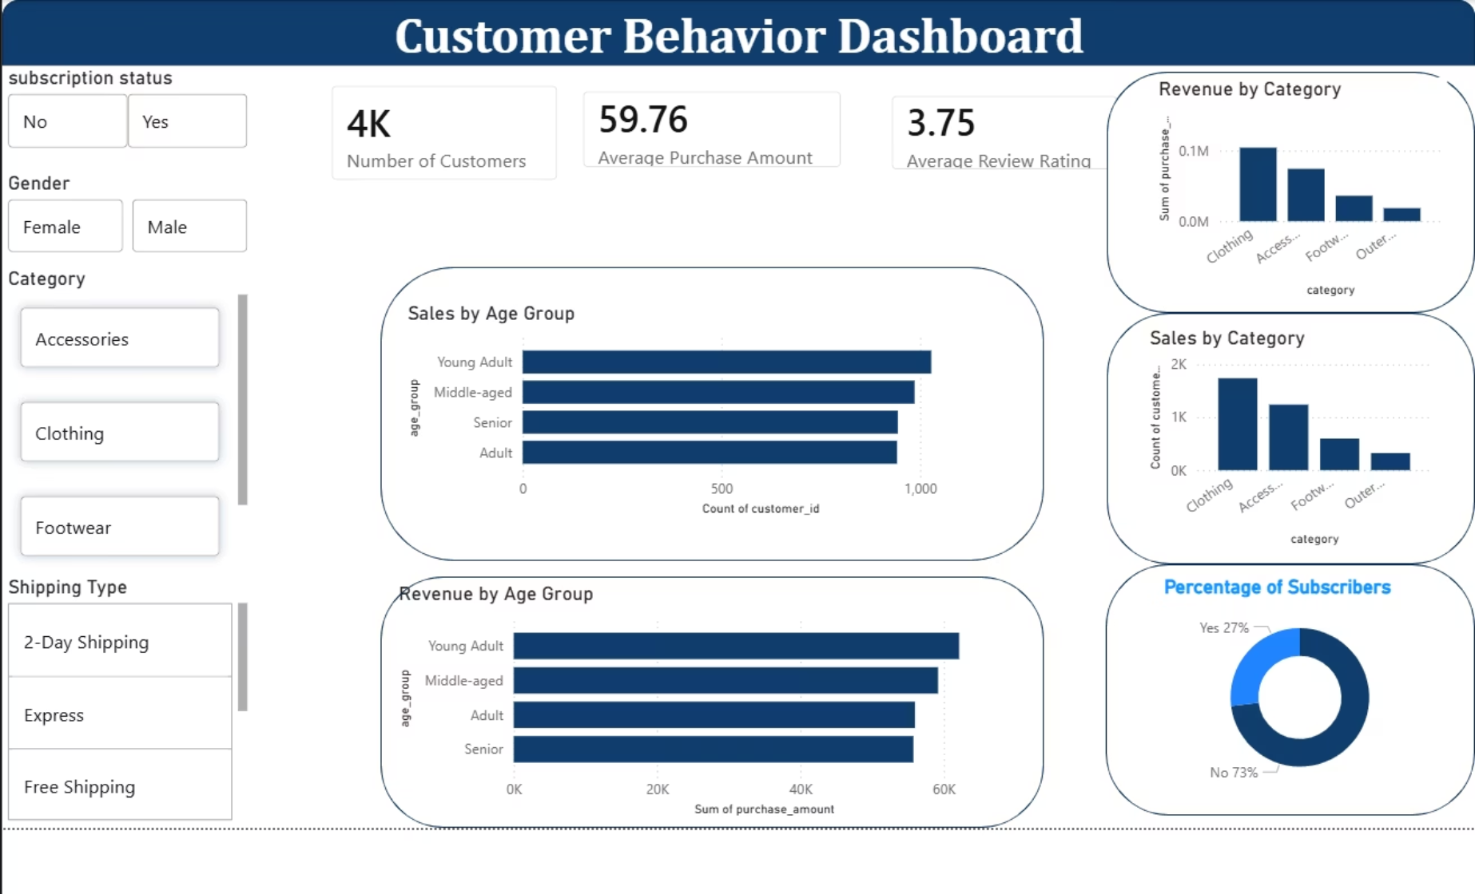
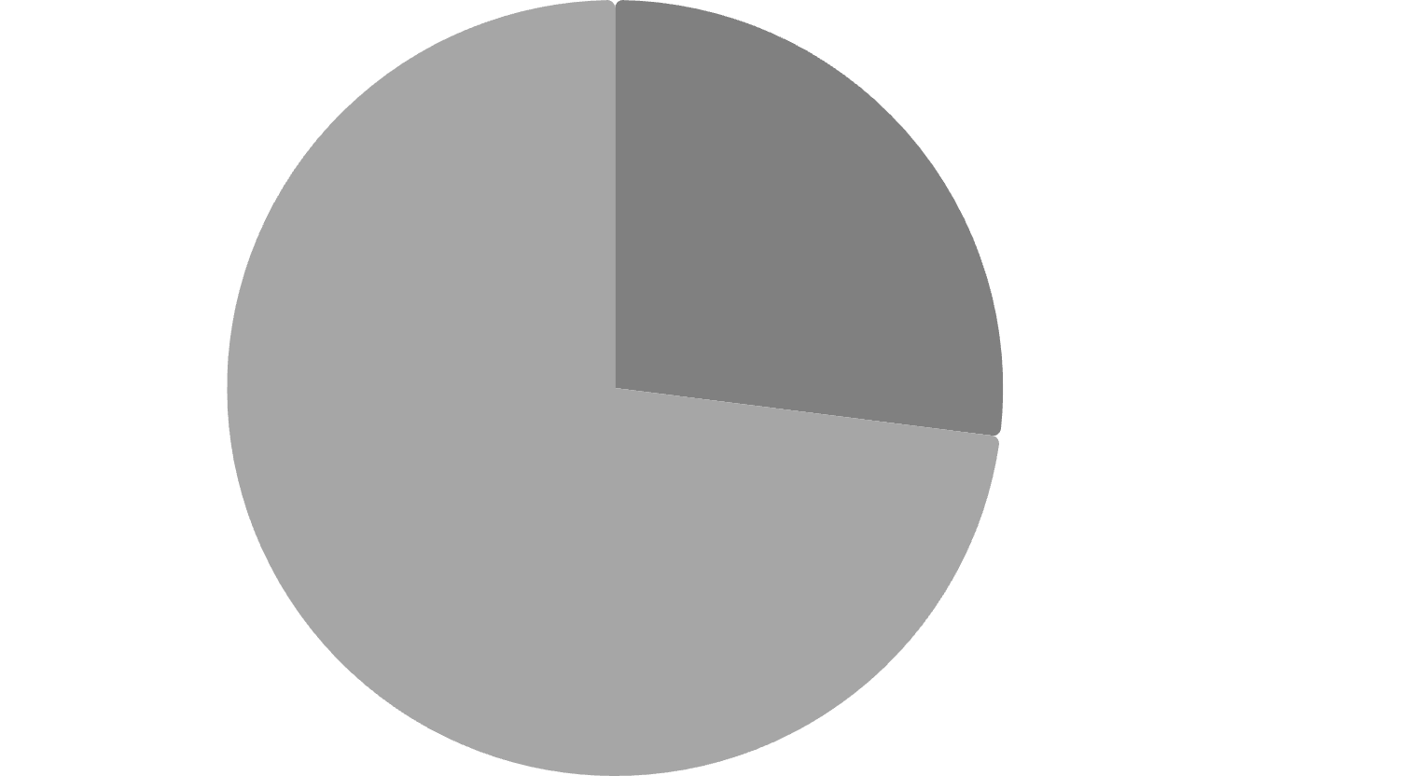
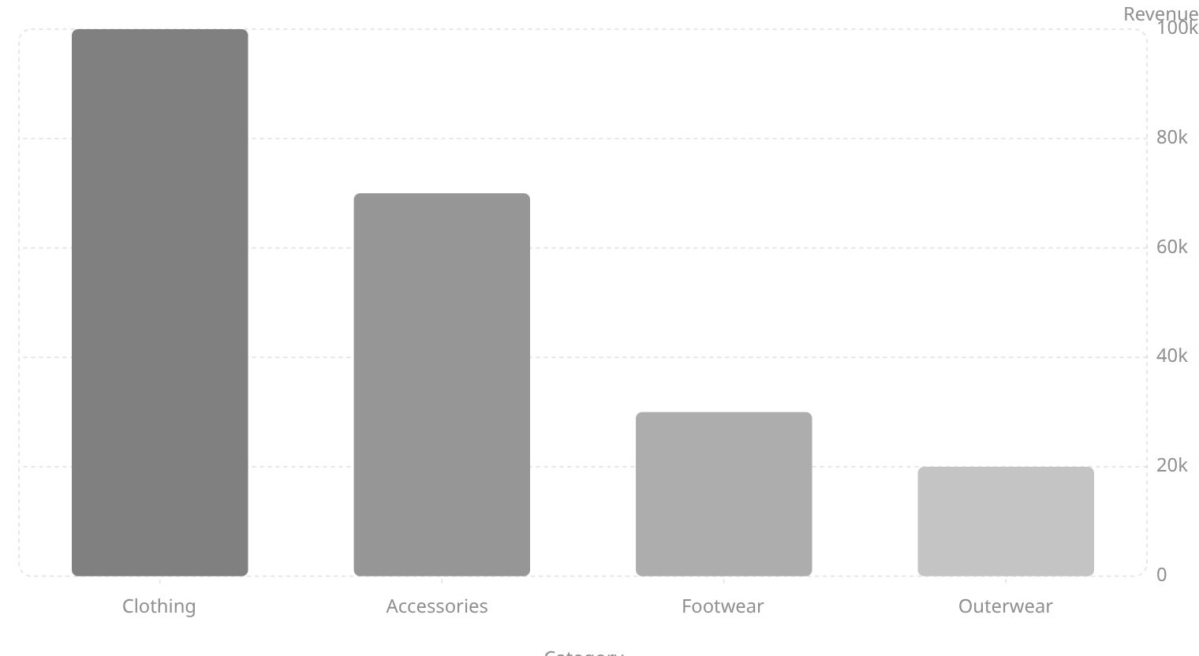
Dashboard in Power BI
Finally, we built an interactive dashboard in Power BI to present insights visually.
Key Metrics:
Number of Customers: 3.9K
Average Purchase Amount: $59.76
Average Review Rating: 3.75
% of Customers by Subscription Status
Revenue by Category
Yes·27%
·27%
·
No·73%
·73%
·

Slide 10
Business Recommendations
Boost Subscriptions
Customer Loyalty Programs
Review Discount Policy
Promote exclusive benefits for subscribers.
Balance sales boosts with margin control.
Reward repeat buyers to move them into the “Loyal” segment.
Product Positioning
Targeted Marketing
Highlight top-rated and best-selling products in campaigns.
Focus efforts on high-revenue age groups and express-shipping users.

